Slide 1
5/25 Meeting
record more data points (ongoing)
2 data points last week (both 4 mm @ ~ 6000 at 125 torr), very low variance by visual examination
may have trouble convincing anyone to let me use an even slightly risky backfill for their shot
optimization of tests for test matrix (completed)
will continue to procedurally update test matrix based on results
send all docs to jacob (done)
look up statistical methods and requirements (done)
model should hold up to review
edit thesis word doc and begin transfer to LaTeX (done)

Slide 2
6/8 Meeting
lit review (ongoing)
collected some articles to review, found some good info to cite for the statements I made in the paper
organized Mendeley
figures for paper
give feedback (done)
make changes (ongoing)

Slide 3
6/15 Meeting
examine paper content and determine which figures are appropriate
thesis content vs journal paper
think of a better term for sabot stripper
literature refers to it as sabot stripper/sabot stripper plate
opportunity to rename it something cool

Slide 4
Future/TODO
3D scan/measure 10/6/4 mm sabots to find center of mass for rotation arguments (TODO)
add in more analysis to the paper based on lit review / further investigation (TODO)

Slide 5
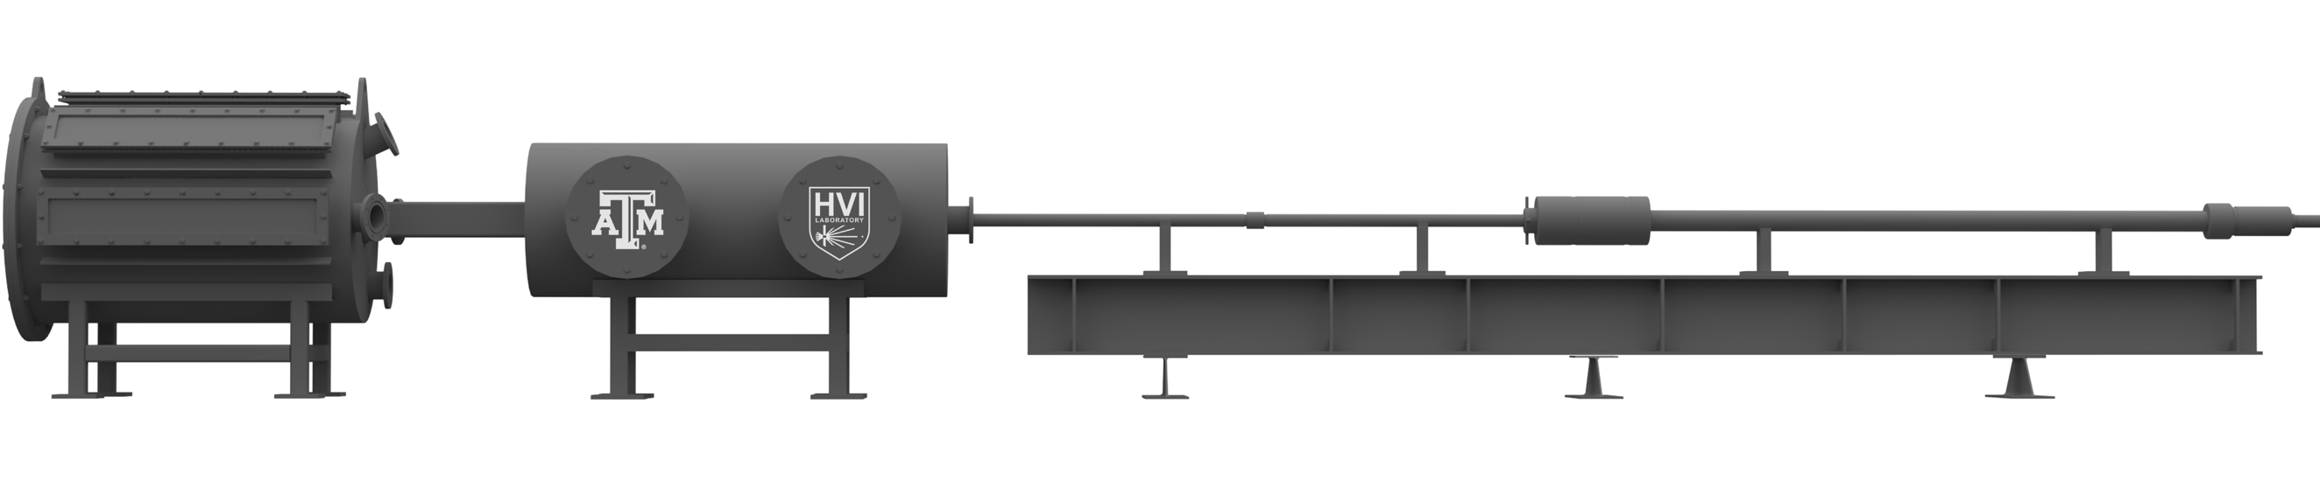
Figure 1
Downrange
Uprange
Muzzle
Central Breech
Sabot Stopping Plate
Powder Breech
Target Tank
Blast Tank
Figure 1: The two-stage light gas gun (2SLGG), with necessary dimensions, located in the TAMU HVI Laboratory. The key components of concern in this work are the muzzle, blast tank, and sabot stopping plate (SSP).
Flight Tube
Pump Tube
1.2 m
y
2.4 m
z
13.7 m

Slide 6
Table 1
Table 1: A summary of key properties for both the 4 mm and 10 mm sabot petals.
Property | 4 mm sabot | 10 mm sabot
Mass (g) | 0.487 | 0.464
Density (g/cc)
Volume (cc) | 0.460 | 0.455
Material? | Nylon | Nylon
Length (mm) |  | 19
Surface area of cutout (mm^2) | 40 | 21
Surface area of cavity (mm^2) | 14 | 61

Slide 7
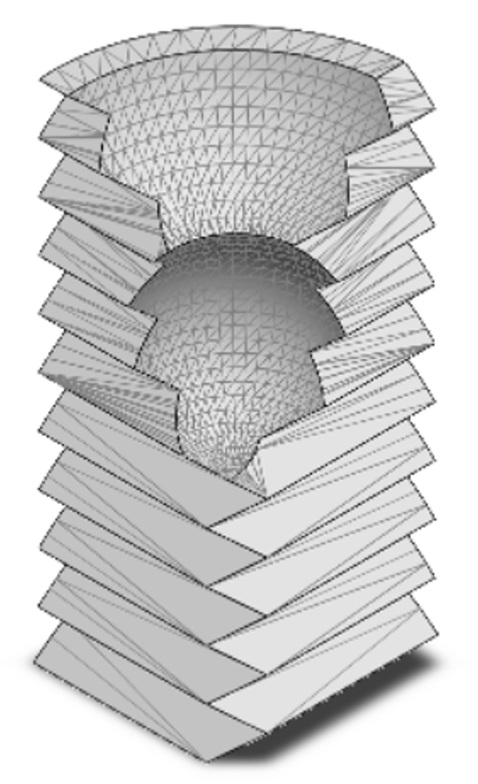
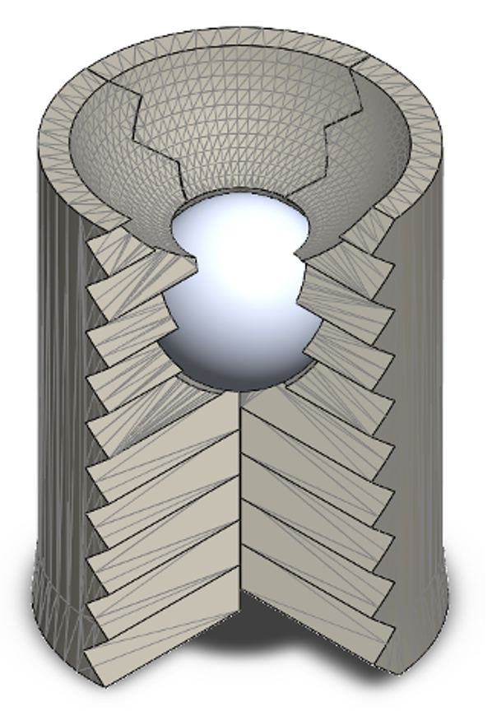
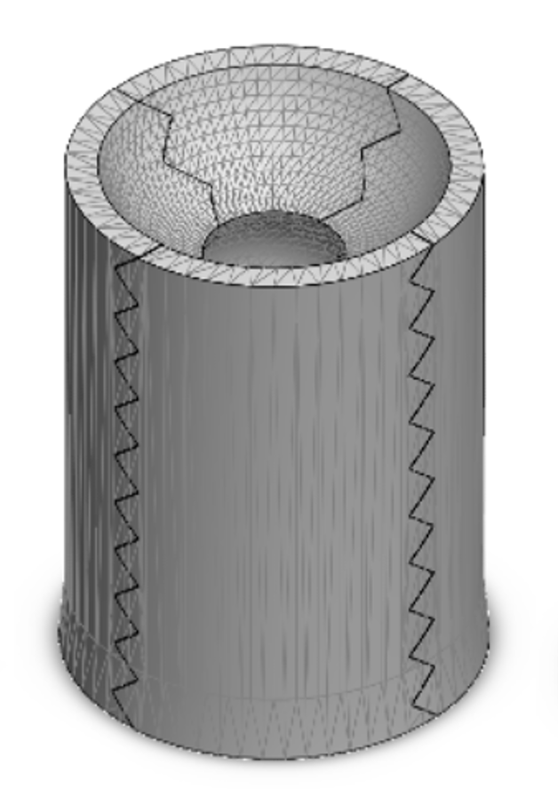
Figure 2
COMMENTS: can we replace these sabot figures with 4- and 10-mm sabot models? This will give the reader an idea of the relative size difference, as 6 mm is not even considered in the paper. Also, can you provide the figures as separate images? I will finish the figure with annotations. I omitted Figure 4 because the ideas can be combined into this figure.
Sabot Petal
Partially Closed Sabot
Fully Closed Sabot
4 mm projectile cavity
Aerodynamic cutout
⌀XX mm
4 mm
45º serration
XX mm
4 mm projectile
Figure 2: Three-dimensional models of the two considered sabot configurations with dimensions and key features: (a)-(c) 4 mm sabot and (d)-(f) 10 mm sabot.
(a)
(b)
(c)
12.7 mm
10 mm projectile cavity
Aerodynamic cutout
⌀XX mm
10 mm
45º serration
XX mm
10 mm projectile
(d)
(e)
(f)
12.7 mm

Slide 8
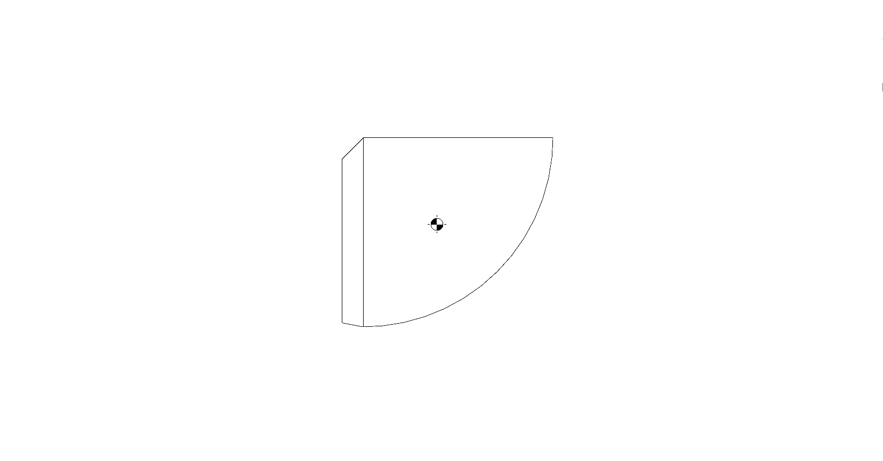
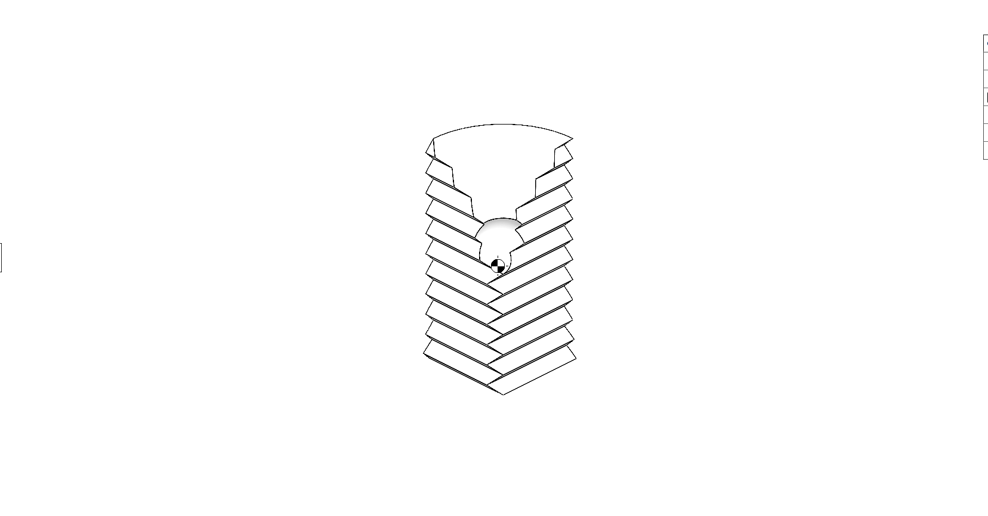
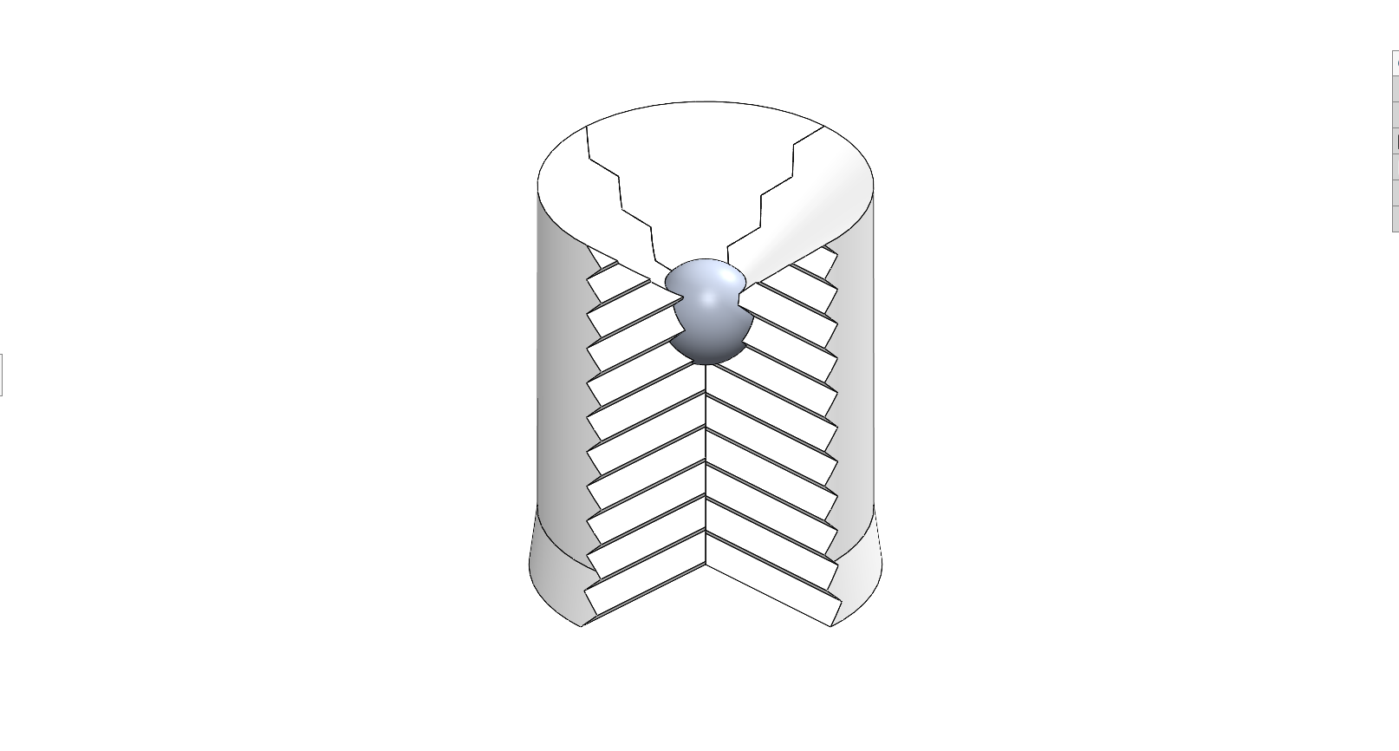
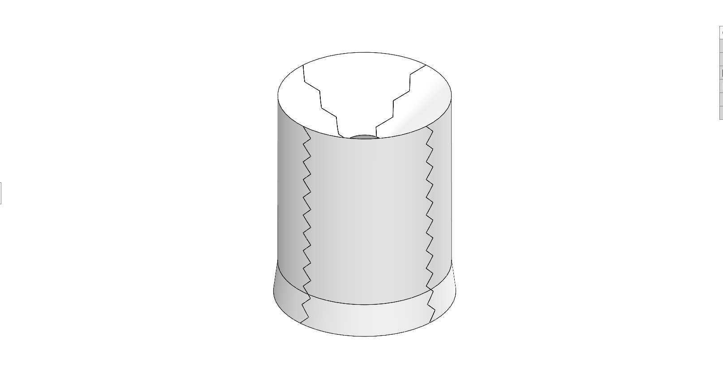
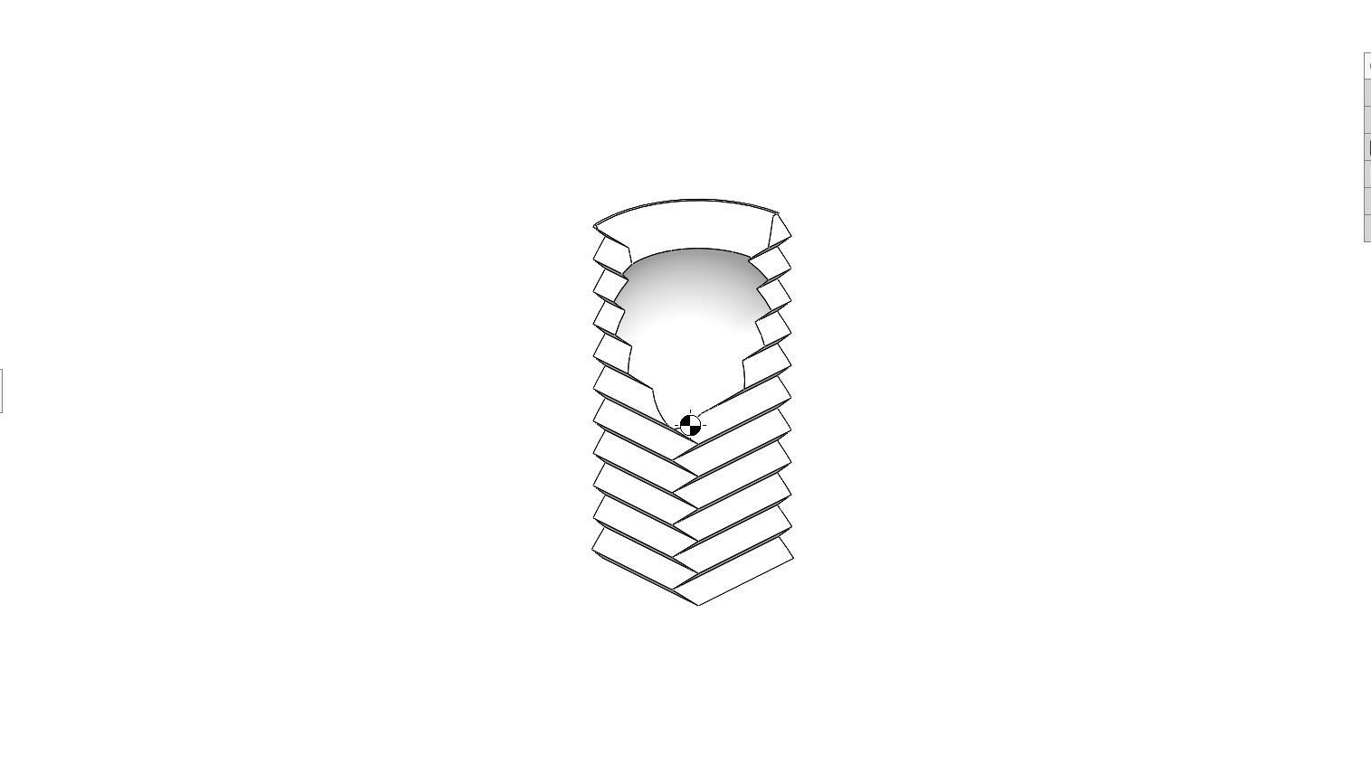
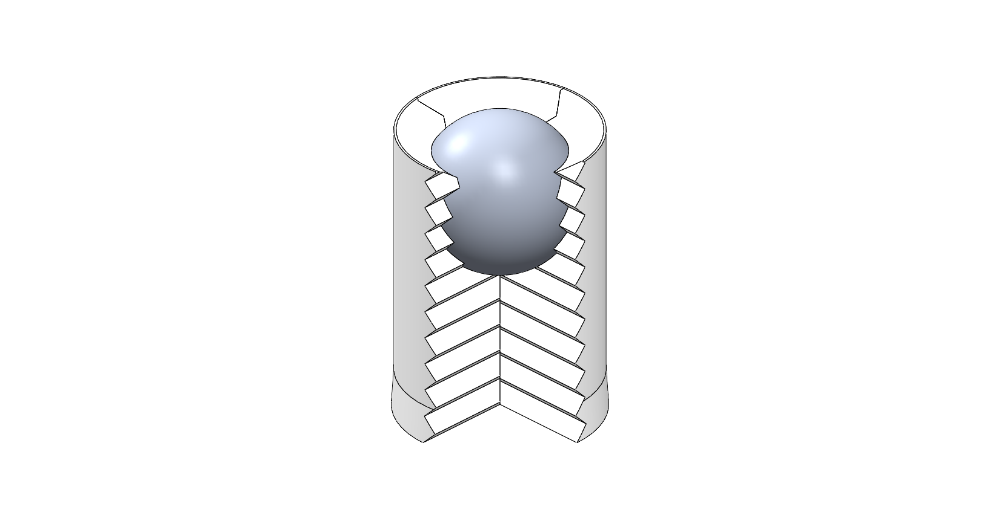
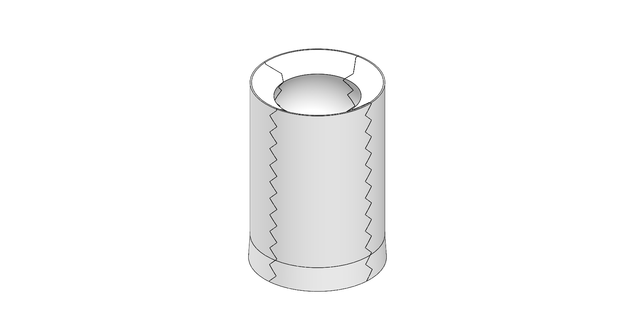
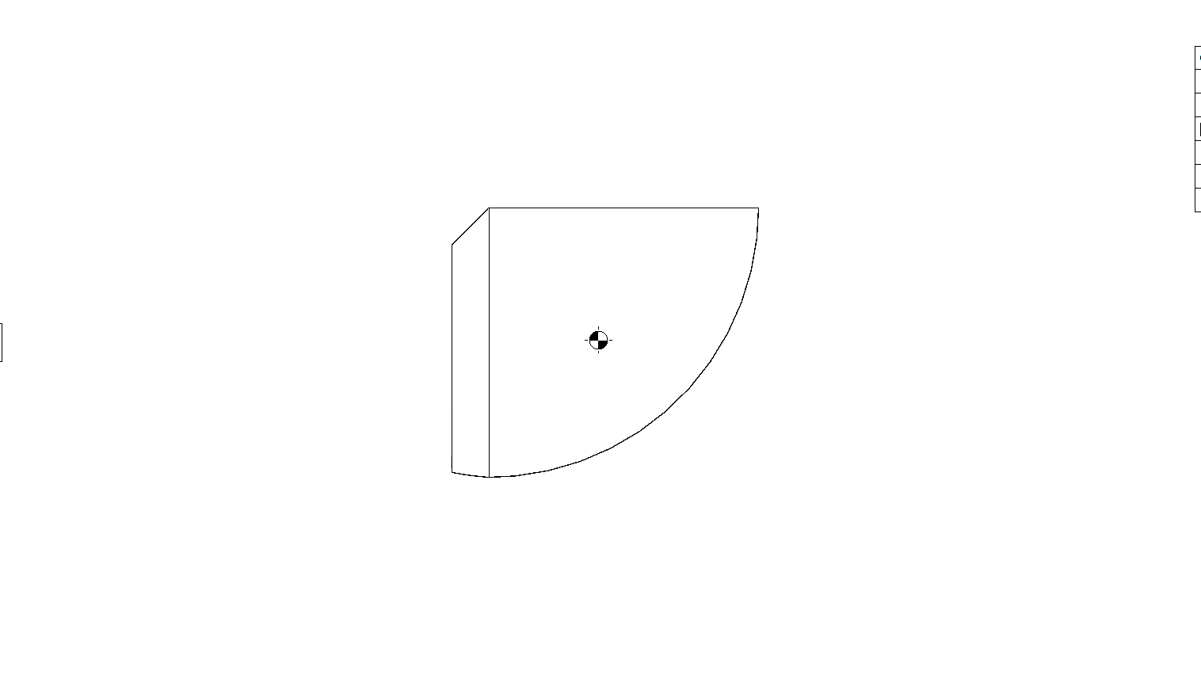
Figure 2
COMMENTS: can we replace these sabot figures with 4- and 10-mm sabot models? This will give the reader an idea of the relative size difference, as 6 mm is not even considered in the paper. Also, can you provide the figures as separate images? I will finish the figure with annotations. I omitted Figure 4 because the ideas can be combined into this figure.
Sabot Petal Bottom
Sabot Petal Isometric
Partially Closed Sabot
Fully Closed Sabot
Projectile
cavity: 14 mm²
Aerodynamic cutout: 40 mm²
⌀3.1 mm
3.1 mm
4 mm
3.3 mm
16.5 mm
7.3 mm
Flare
4 mm projectile
Figure 2: Three-dimensional models of the two considered sabot configurations with dimensions and key features: (a)-(c) 4 mm sabot and (d)-(f) 10 mm sabot.
45º serration
(a)
(b)
(c)
(d)
12.7 mm
Projectile
cavity: 61 mm²
Aerodynamic cutout: 21 mm²
⌀8.2 mm
3.2 mm
10 mm
3.5 mm
19 mm
7.7 mm
Flare
10 mm projectile
45º serration
(e)
(f)
(g)
(h)
12.7 mm

Slide 9
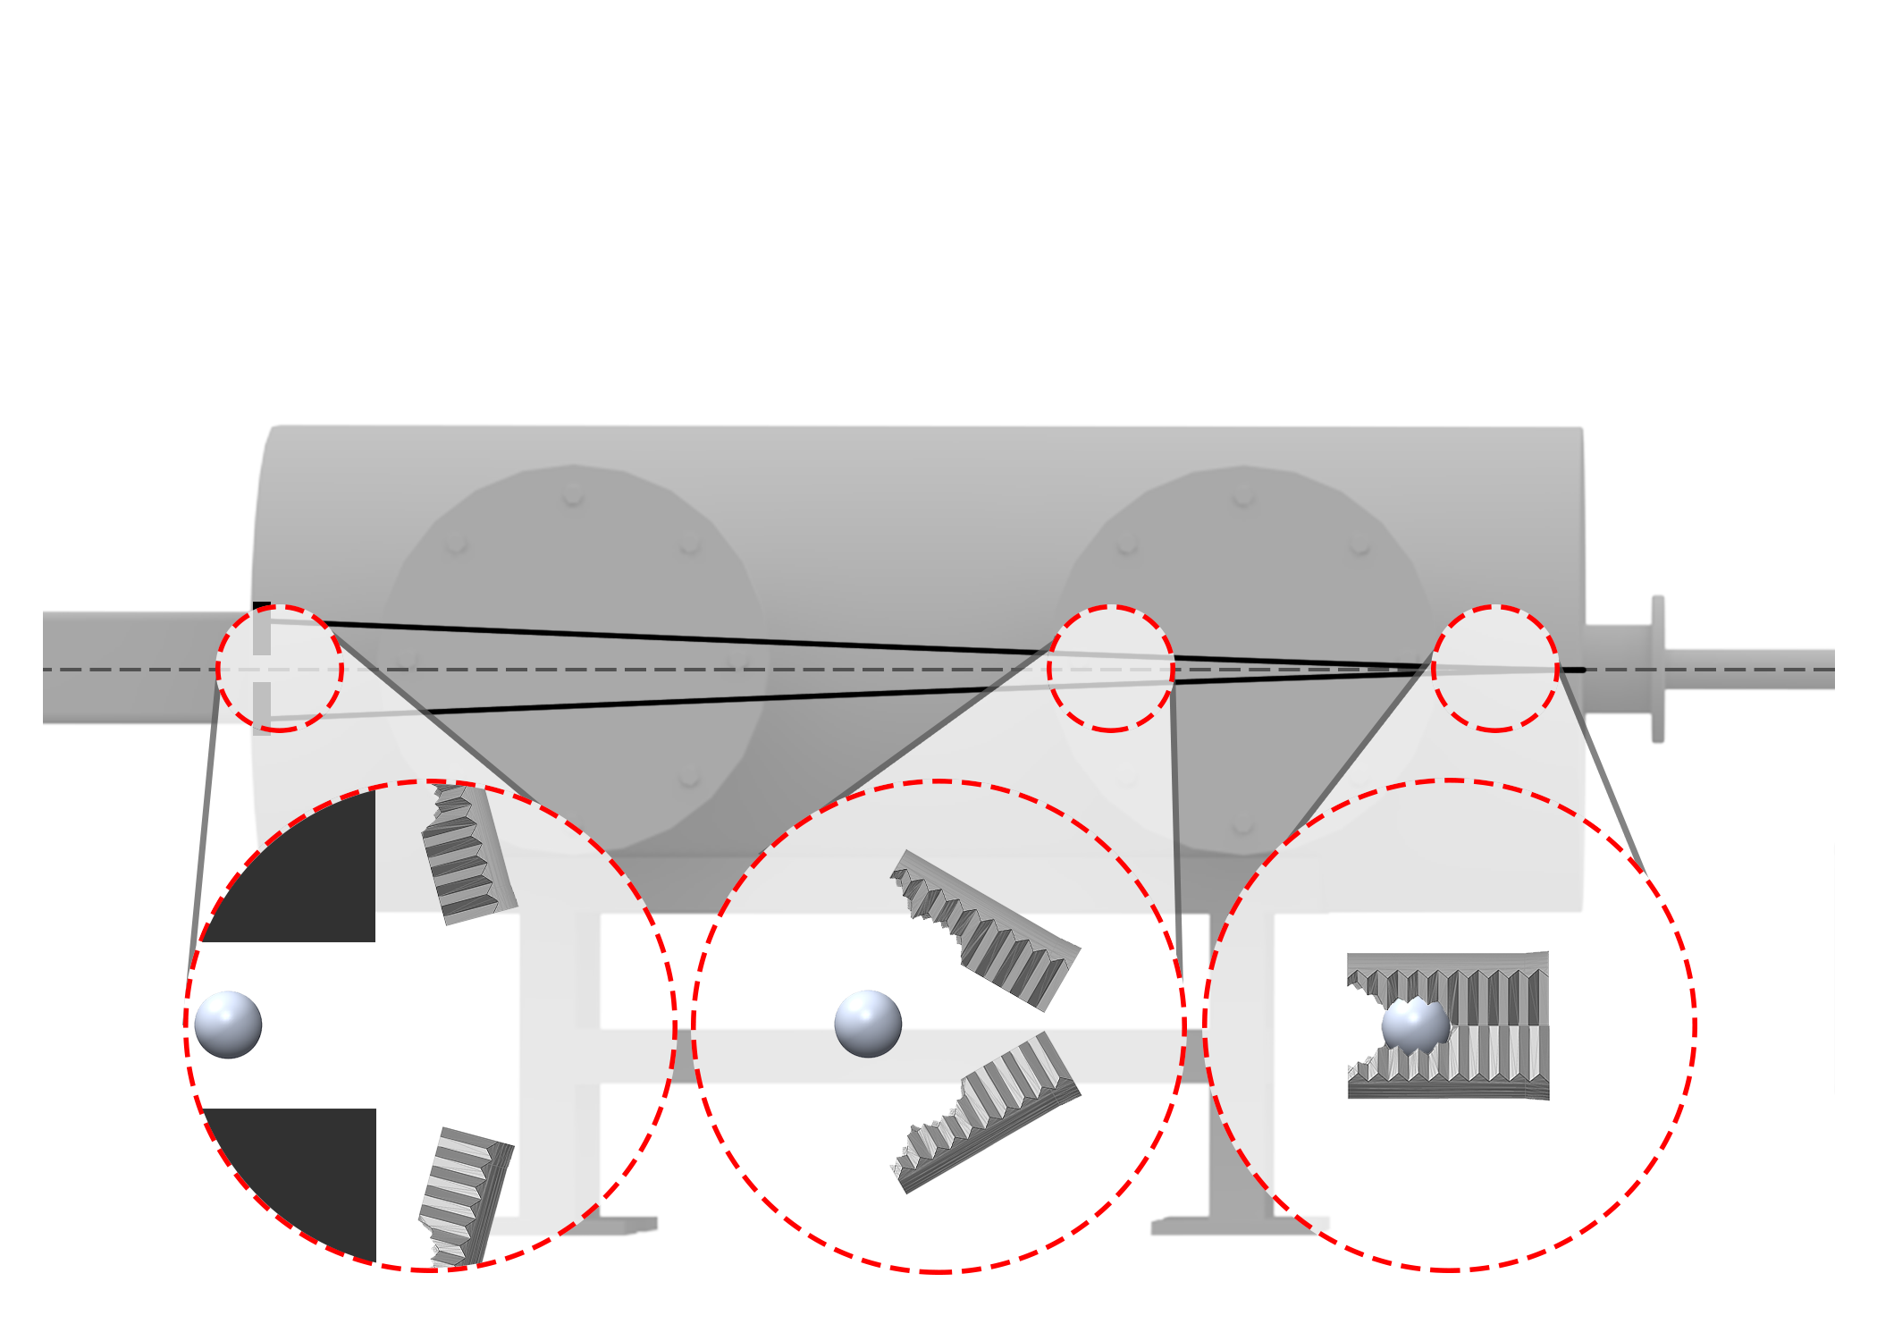
Figure 3
Downrange
Sabot stopping plate (SSP)
Uprange
Sabot flight path
Projectile flight path
Drift Tube
Blast Tank
Figure 3: The main sequence of events during aerodynamic sabot separation: (1) projectile package exits the 2SLGG launch tube muzzle, (2) sabot petals aerodynamically separate from the projectile, and (3) the sabot petals impact the sabot stopping plate (SSP) as the projectile enters drift tube. Only two sabot petals are shown for visualization purposes.
y
z
(3)
(2)
(1)

Slide 10
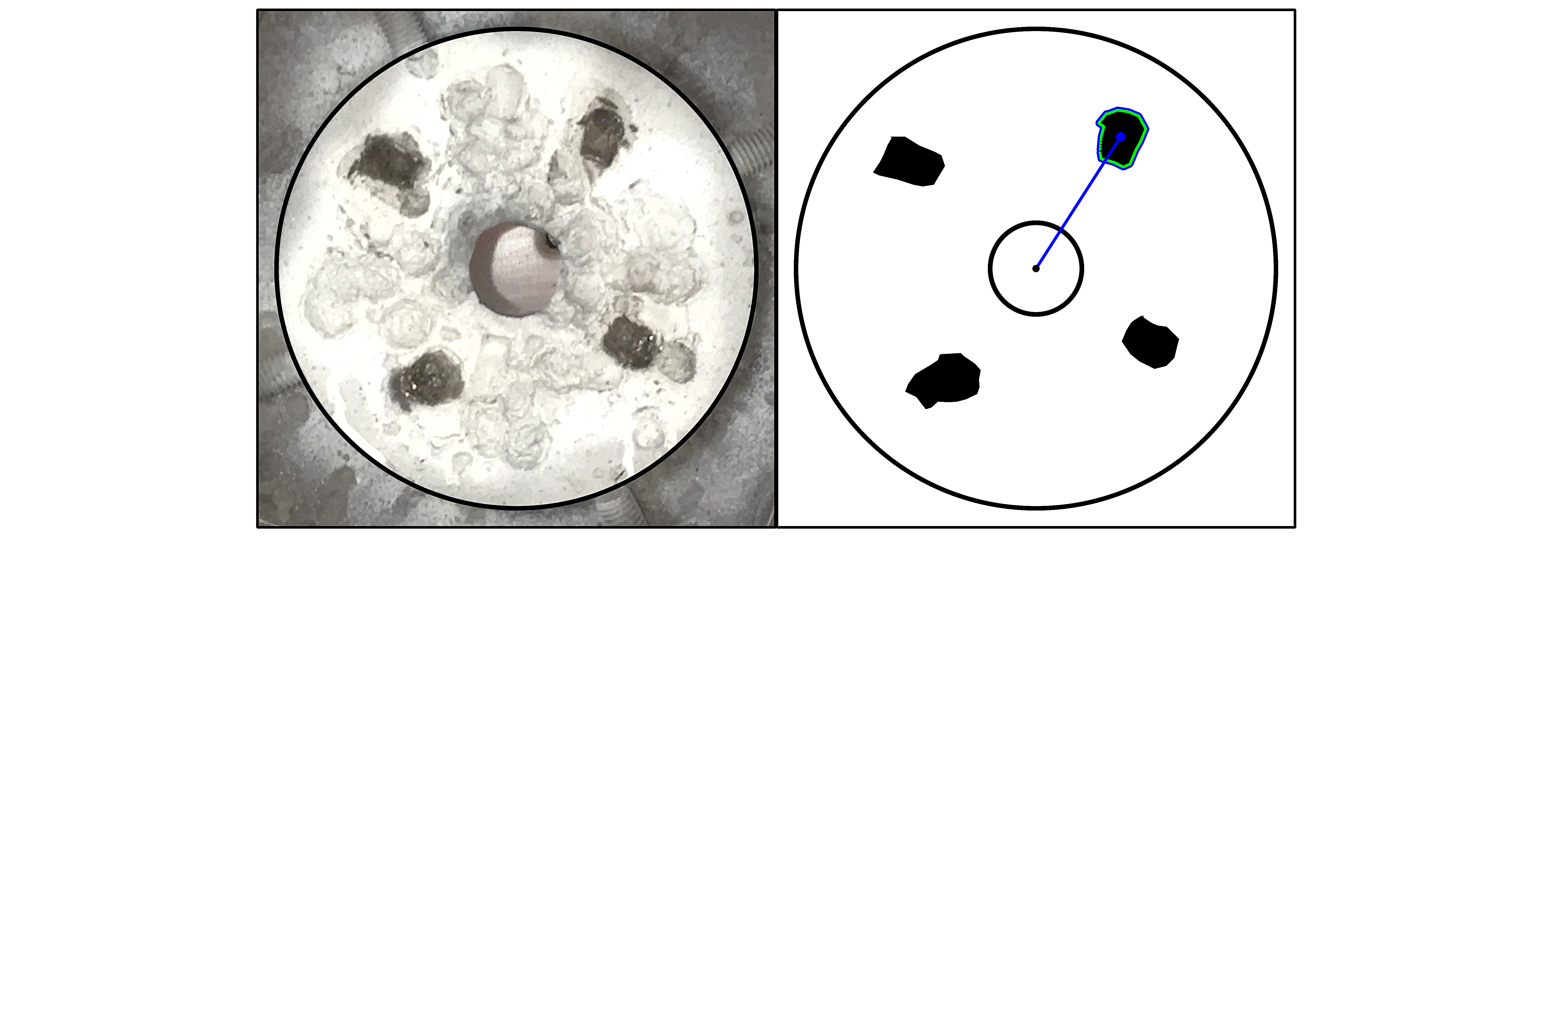
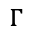
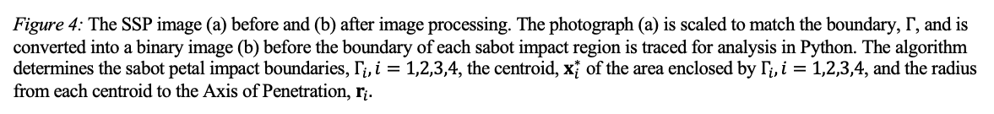
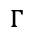
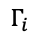
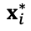
Figure 4
(a)
y
(b)
y
Sabot impact
x
$$x_{i}^{∗}$$
x
Figure 4: The SSP image (a) before and (b) after image processing. The photograph (a) is scaled to match the boundary, $Γ$, and is converted into a binary image (b) before the boundary of each sabot impact region is traced for analysis in Python. The algorithm determines the sabot petal impact boundaries, $Γ_{i}, i=1,2,3,4$, the centroid, $x_{i}^{∗}$ of the area enclosed by $Γ_{i},i=1,2,3,4$, and the radius from each centroid to the Axis of Penetration, $r_{i}.$
2
2
$$Γ_{i}$$
2
1
$$r_{i}$$
2
1
1
AoP
Ø31.8 mm
4
4
4
4
3
3
Ø152.4 mm
Photograph
$$Γ$$
Binary Image
$$Γ$$

Slide 11
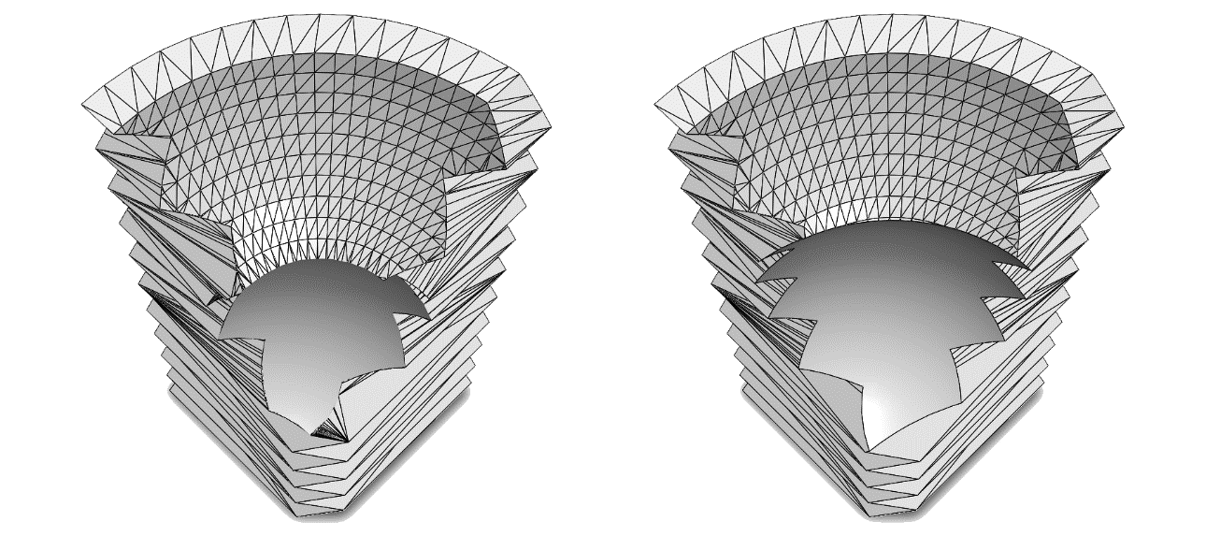
Figure 4
Necessary to show difference in downrange end of 10/4 mm sabot. This can be combined/reconfigured to show the center of mass to demonstrate the moment of inertia
Identify the different aspects. Make sure this figure is necessary and can stand alone. What is it in this figure that makes it necessary? Why not just use Fig. 2?

Slide 12
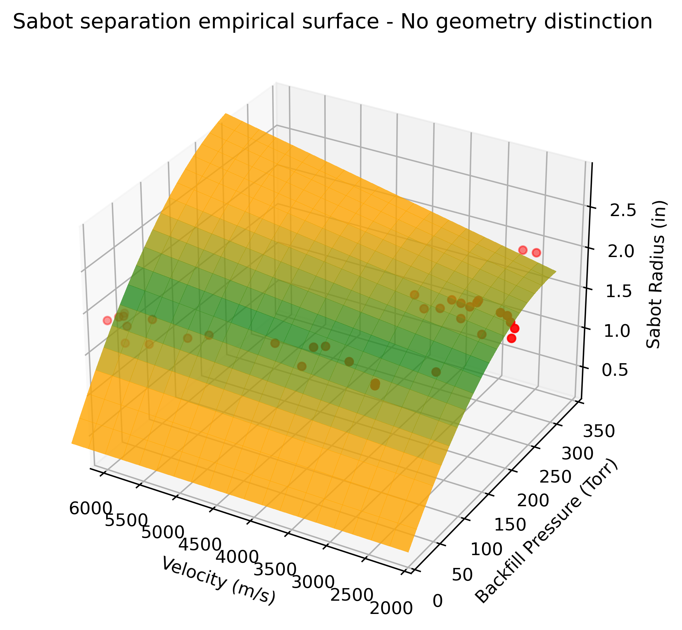
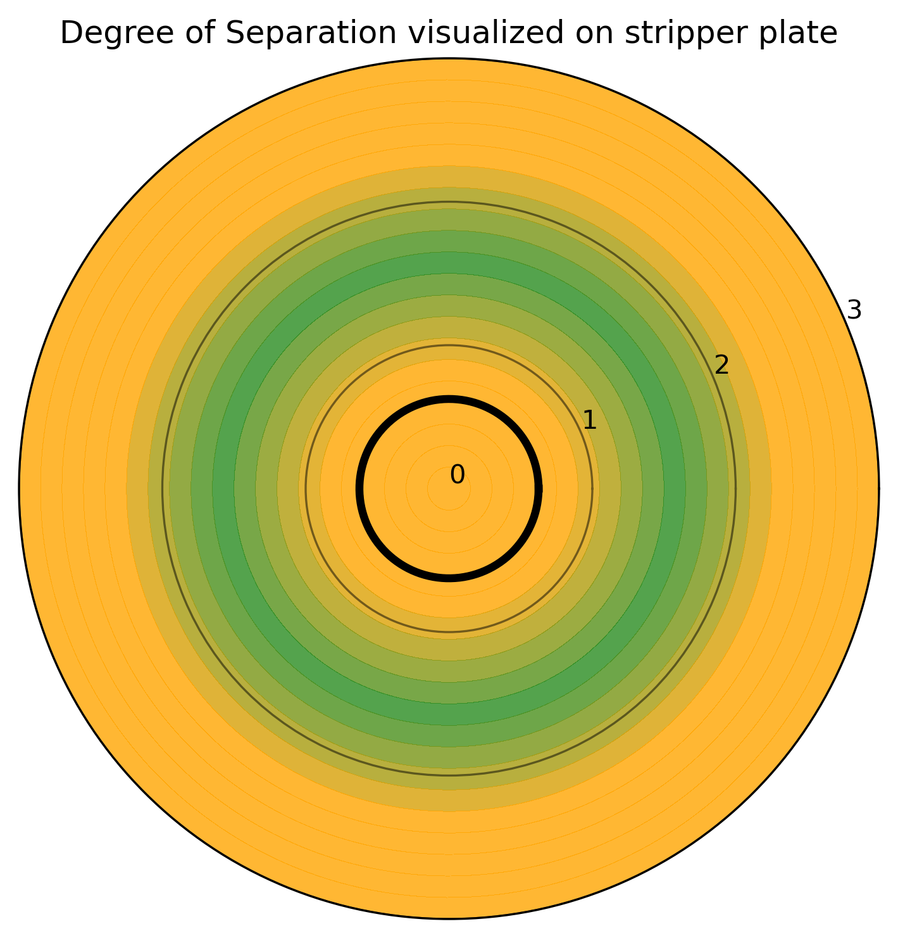
Figure 4
(a)
(b)
I like figure (b), but you may want to add notes/text to indicate what the different regions mean to the reader. Also, you need to indicate that it is a sabot stripping plate. For figure (a), we need to convert from m/s to km/s, and from inches to mm. We want a white background and make the view isometric. I would also fix the gridlines so they evenly spaced. Essentially, clean up the axes.

Slide 13
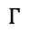
y
x
AoP
Ø152.4 mm
$$Γ$$

Slide 14
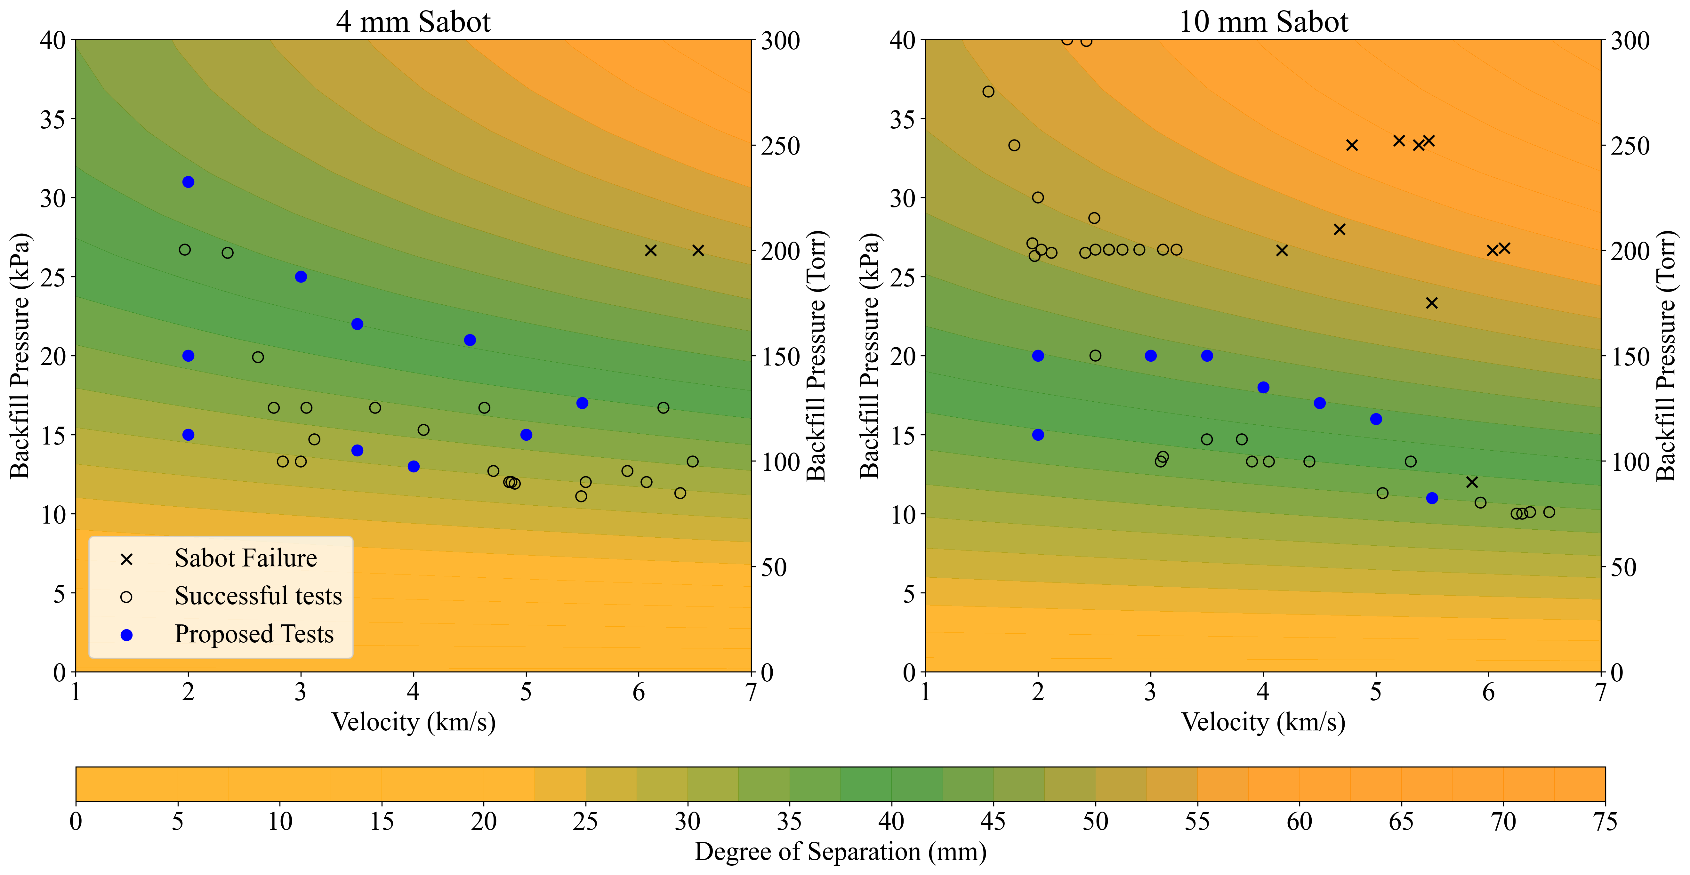
Figure 5
Figure 5
(a)
(b)
(c)
(d)

Slide 15
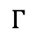
Figure 6
y
x
AoP
Ø31.8 mm
Ø152.4 mm
$$Γ$$
(a)
(b)

Slide 16







"There is nothing more fulfilling than to serve your country and your fellow citizens and to do it well.” – Pres. George H.W. Bush
Contact Information: Director Manager
Dr. Tom Lacy, MEEN Dr. Raj Kota, BCDC
TELacyJr@TAMU.edu KKRaj@TAMU.edu
(662) 948-9213 (cell) (662) 617-9196 (cell)

